Slide 1
“Age of the Earth”
Matt Bracewell, Ed.D.
Liberty Christian Academy
Nov. 21, 2022

Slide 2
My Family
Merritt Elizabeth
Ridge Wilson
Briana
Watson David
Griffin Wayne

Slide 3
Why Am I Here?
Battle experience- 35 years of public-school experience
K through Ed.D
17+ years of public school teaching experience
Began studying Creation science in 2009
Encouragement
Use for Gospel
I have a purpose!!

Slide 5
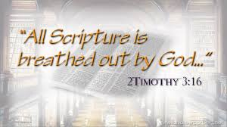
The Bible’s Purpose
“All scripture is given by inspiration of God, and is profitable for doctrine, for reproof, for correction, for instruction in righteousness.”
2 Timothy 3:16 (KJV)

Slide 6
The Christian’s Purpose
“But sanctify the Lord God in your hearts and be ready always to give an answer to every man that asketh you a reason of the hope that is in you with meekness and fear.”
1 Peter 3:15 (KJV)

Slide 7
The Apologetics’ Purpose
“Study to shew thyself approved unto God, a workman that needeth not to be ashamed, rightly dividing the word of truth.”
2 Timothy 2:15 (KJV)

Slide 8
Science Time!!
Please help me with the mystery of the burning candle!

Slide 9
Scientific Method
State the Question
Gather Information
Form a Hypothesis
Experiment/Test Hypothesis
Analyze Results
State Your Conclusion

Slide 10
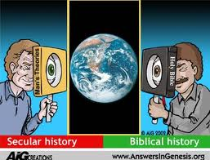

Slide 11
4 Great Questions of Life
Who am I (and what am I worth)?
Where did I come from?
Why am I here?
Where am I going when I die?

Slide 12
4 Great Questions of Life
Questions:
The Bible says…
Who am I (and what am I worth)?
Where did I come from?
Why am I here?
Where am I going when I die?
You are the highest of God’s creation (Gen. 1:26).
God created man in His image (Gen. 1:26)
You are here to worship God the Creator by praising Jesus Christ the beloved Son with power of the Holy Spirit.
You will go to Heaven OR hell after this life
(Heb. 9:27).

Slide 13
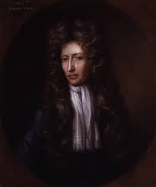
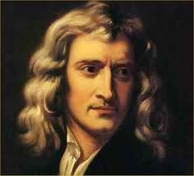
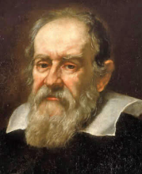
Creationist Fruits
True Science
Founding fathers of modern science (Newton, Kepler, Boyle, Galileo) were creationists, “thinking God’s thoughts after Him.”
Scientific method based on premise of orderly creation, capable of being understood & rationally described due to its intelligent Creator.
Many of our modern inventions were first developed by Bible-believing scientists.

Slide 14
Our Creationist Heritage
Antiseptic Surgery
Bacteriology
Calculus
Celestial Mechanics
Chemistry
Comparative Anatomy
Computer Science
Dimensional Analysis
Dynamics
Electrodynamics
Joseph Lister (1827-1912)
Louis Pasteur (1822-1895)
Isaac Newton (1642-1727)
Johann Kepler (1571-1630)
Robert Boyle (1627-1691)
Georges Cuvier (1769-1832)
Charles Babbage (1792-1871)
Lord Rayleigh (1842-1919)
Isaac Newton (1642-1727)
James Clerk Maxwell (1831-1879)

Slide 15
Our Creationist Heritage
Electromagnetics
Electronics
Energetics
Entomology of Living Insects
Field Theory
Fluid Mechanics
Galactic Astronomy
Gas Dynamics
Genetics
Glacial Geology
Michael Faraday (1791-1867)
Ambrose Fleming (1849-1945)
Lord Kelvin (1824-1907)
Henri Fabre (1823-1915)
Michael Faraday (1791-1867)
George Stokes (1819-1903)
William Herschel (1738-1822)
Robert Boyle (1627-1691)
Gregor Mendel (1822-1884)
Louis Agassiz (1807-1873)

Slide 16
Our Creationist Heritage
Gynecology
Hydraulics
Hydrography
Hydrostatics
Ichthyology
Isotopic Chemistry
Model Analysis
Natural History
Non-Euclidean Geometry
Oceanography
James Simpson (1811-1870)
Leonardo da Vinci (1452-1519)
Matthew Maury (1806-1873)
Blaise Pascal (1623-1662)
Louis Agassiz (1807-1873)
William Ramsay (1852-1916)
Lord Rayleigh (1842-1919)
John Ray (1627-1705)
Bernhard Riemann (1826-1866)
Matthew Maury (1806-1873)

Slide 17
Our Creationist Heritage
Optical Mineralogy
Paleontology
Pathology
Physical Astronomy
Reversible Thermodynamics
Statistical Thermodynamics
Stratigraphy
Systematic Biology
Thermodynamics
Vertebrate Paleontology
David Brewster (1781-1868)
John Woodward (1665-1728)
Rudolph Virchow (1821-1902)
Johann Kepler (1571-1630)
James Joule (1818-1889)
James Clerk Maxwell (1831-1879)
Nicholas Steno (1631-1686)
Carolus Linnaeus (1707-1778)
Sir Humphrey Davy (1778-1829)
Georges Cuvier (1769-1832)

Slide 18
Notable Inventions, Discoveries, or Developments by Bible-believing Scientists
Contribution
Scientists
Absolute Temp. Scale
Actuarial Tables
Barometer
Biogenesis Law
Calculating Machine
Chloroform
Classification System
Double Stars
Electric Generator
Electric Motor
Lord Kelvin (1824-1907)
Charles Babbage (1792-1871)
Blaise Pascal (1623-1662)
Louis Pasteur (1822-1895)
Charles Babbage (1792-1871)
James Simpson (1811-1870)
Carolus Linnaeus (1707-1778)
William Herschel (1738-1822)
Michael Faraday (1791-1867)
Joseph Henry (1797-1878)

Slide 19
Notable Inventions, Discoveries, or Developments by Bible-believing Scientists
Contribution
Scientists
Ephemeris Tables
Fermentation Control
Galvanometer
Global Star Catalog
Inert Gases
Kaleidoscope
Law of Gravity
Mine Safety Lamp
Pasteurization
Reflecting Telescope
Johann Kepler (1571-1630)
Louis Pasteur (1822-1895)
Joseph Henry (1797-1878)
John Herschel (1792-1871)
William Ramsay (1852-1916)
David Brewster (1781-1868)
Isaac Newton (1642-1727)
Sir Humphrey Davy (1778-1829)
Louis Pasteur (1822-1895)
Isaac Newton (1642-1727)

Slide 20
Notable Inventions, Discoveries, or Developments by Bible-believing Scientists
Contribution
Scientists
Scientific Method
Self-induction
Telegraph
Thermionic Valve
Trans-Atlantic Cable
Vaccination & Immunization
Francis Bacon (1561-1626)
Joseph Henry (1797-1878)
Samuel F.B. Morse (1791-1872)
Ambrose Fleming (1849-1945)
Lord Kelvin (1824-1907)
Louis Pasteur (1822-1895)

Slide 21
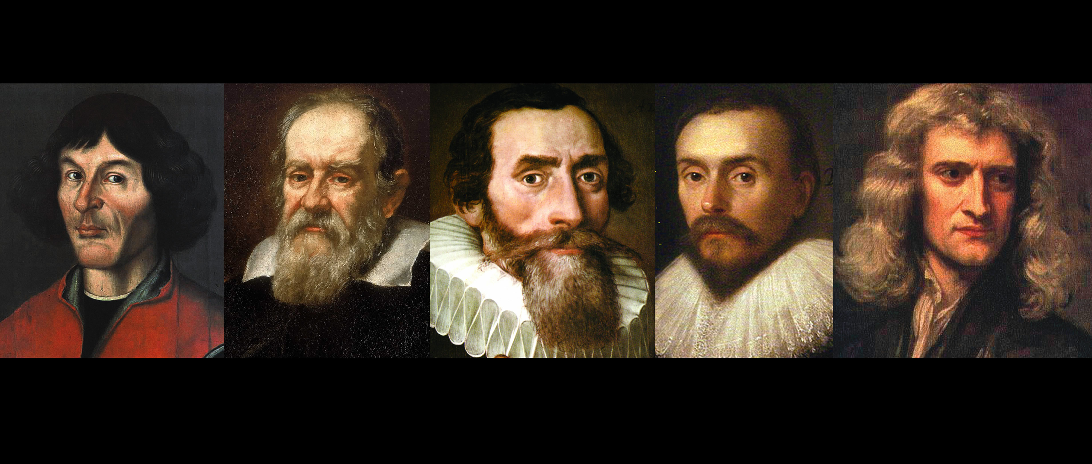
Were all creationists too “stupid” to understand evolution, or….
just “smart enough” to acknowledge their Creator??

Slide 22
Science Allusions in Scripture
Scripture
Phenomenon/Process
Hydrologic Cycle
Evaporation
Condensation Nuclei
Condensation
Precipitation
Run-off
Oceanic Reservoir
Snow
Hydrologic Balance
Ec. 1:7; Is. 55:10
Ps. 135:7; Je. 10:13
Pr. 8:26
Job 26:8; 37:11, 16
Job 36:26-28
Job 28:10
Ps. 33:7
Job 38:22; Ps. 147:16
Job 28:24-26

Slide 23
Science Allusions in Scripture
Phenomenon/Process
Scripture
Springs in Sea
Principle of Isostasy
Shape of Earth
Rotation of Earth
Gravitation
Rock Erosion
Glacial Period
Uniformitarianism
Dinosaurs
Job 38:16
Is. 40:12; Ps. 104:5-9
Is. 40:22; Job 26:10; Ps. 103:12
Job 38:12, 14
Job 26:7; 38:6
Job 14:18-19
Job 38:29-30
2 Pet. 3:4
Job 40-41

Slide 24
Science Allusions in Scripture
Phenomenon/Process
Scripture
Size of Universe
Number of Stars
Uniqueness of Each Star
Precision of Orbits
Atmosphere’s Circulation
Protective Atmosphere
Oceanic Origin- rain
Relation of Electricity- rain
Fluid Dynamics
Job 11:7-9; 22:12; Is. 55:9; Je. 31:17
Ge. 22:17; Je. 33:22
1 Cor. 15:41
Je. 31:35-36
Ec. 1:6
Is. 40:22
Ec. 1:7
Job 28:26; Je. 10:13
Job 28:25

Slide 25
Science Allusions in Scripture
Phenomenon/Process
Scripture
Blood circulation
Psychotherapy
Biogenesis/Stability
Uniqueness of Man
Chemical Nature- Flesh
Cave-men
Mass-Energy Equivalent
Source of Energy- Earth
Atomic Disintegration
Lev. 17:11
Pr. 16:24; 17:22
Gen. 1:11, 21, 25
Gen. 1:26
Gen. 1:11, 24; 2:7; 3:19
Job 12:23-25; 30:3-8
Col. 1:17; Heb. 1:3
Ps. 19:6
2 Pet. 3:10

Slide 26
Science Allusions in Scripture
Phenomenon/Process
Scripture
Electrical Transmission of Info.
Television
Rapid Transportation
Job 38:35
Rev. 11:9-11
Dan. 12:4

Slide 27
True Education
Transmitting truth learned by obedience to dominion mandate from one generation to next (subdue earth)
Centered and controlled in home & family, stressing obedience to God and His Word (Gen. 18:18-19; Eph. 6:4)
Transmitting God’s truth through His people (Matt. 28:19-20; 2 Tim. 3:16)

Slide 28
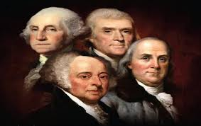
True Americanism
Founding fathers of American system- though not all Bible-believing Christians were creationists.
Declaration of Independence assumes American freedom is ensured by obedience to Creator (e.g. “all men created equal”).
Background of Constitution based on English common law, derived from Scripture, and efforts of many Bible-believing founding fathers

Slide 29
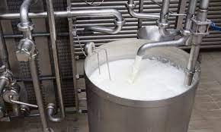
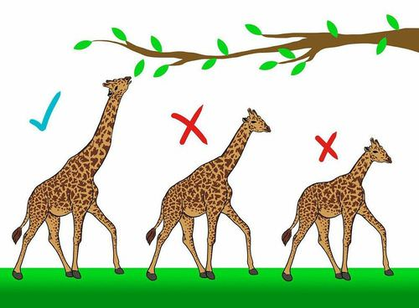
Scientific Evidences Best Explained by the Creation Model
The first and second laws of thermodynamics
Everything has a beginning
Everything works towards disorder
The complexity of the universe and of life
Cells
The statistical improbability of the spontaneous generation of life (Pasteur, Tyndall)
Experiments for hundreds of years disproving life from non-life
The statistical improbability/impossibility of evolution by random mutations and natural selection
Adaptations do NOT equal random beneficial mutations

Slide 30
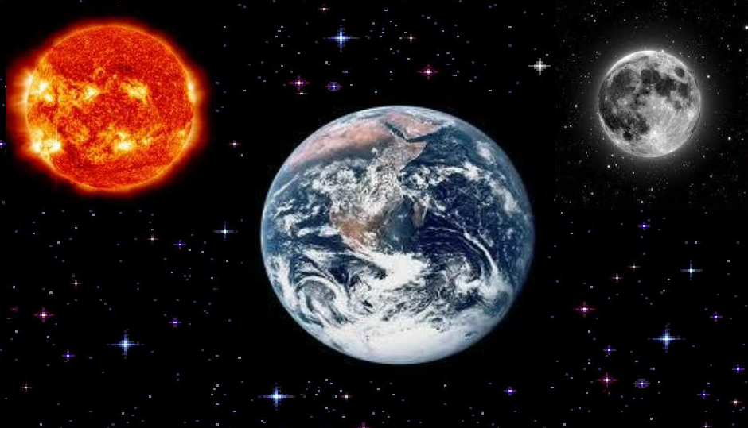
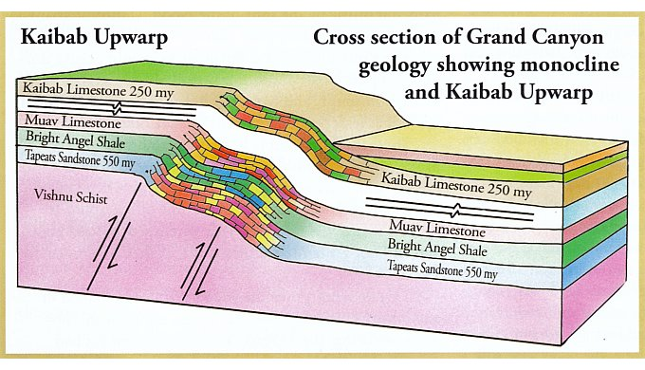
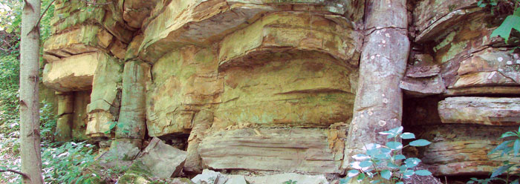
Scientific Evidences Best Explained by the Creation Model
The fossil record (Noah’s Flood)
Fossils represent judgment
Polystrate fossils (passing through multiple layers)
Geological evidences for a young earth (Grand Canyon, Sahara, coral reefs, ice core samples, etc.)
Each can be considered as 4,000-6,000 years old
Sun-Moon-Earth system
Tides, seasons, day-to-day predictions
MANY, MANY MORE!!

Slide 31
Maybe there’s an explanation??
2 Peter 3:3-5:
³ Knowing this first, that there shall come in the last days scoffers, walking after their own lusts,
⁴ And saying, Where is the promise of his coming? for since the fathers fell asleep, all things continue as they were from the beginning of the creation.
⁵ For this they willingly are ignorant of, that by the word of God the heavens were of old, and the earth standing out of the water and in the water:

Slide 32
Maybe there’s an explanation??
2 Peter 3:6-7:
⁶ Whereby the world that then was, being overflowed with water, perished:
⁷ But the heavens and the earth, which are now, by the same word are kept in store, reserved unto fire against the day of judgment and perdition of ungodly men.”

Slide 33
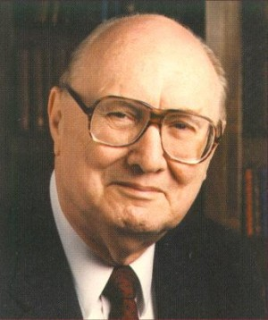
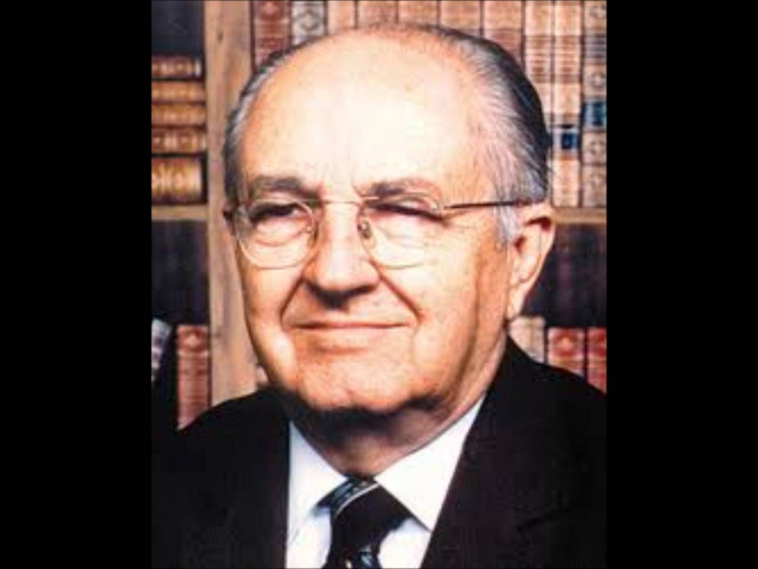
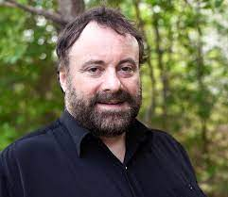
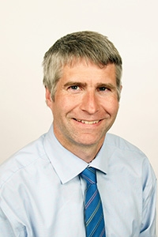
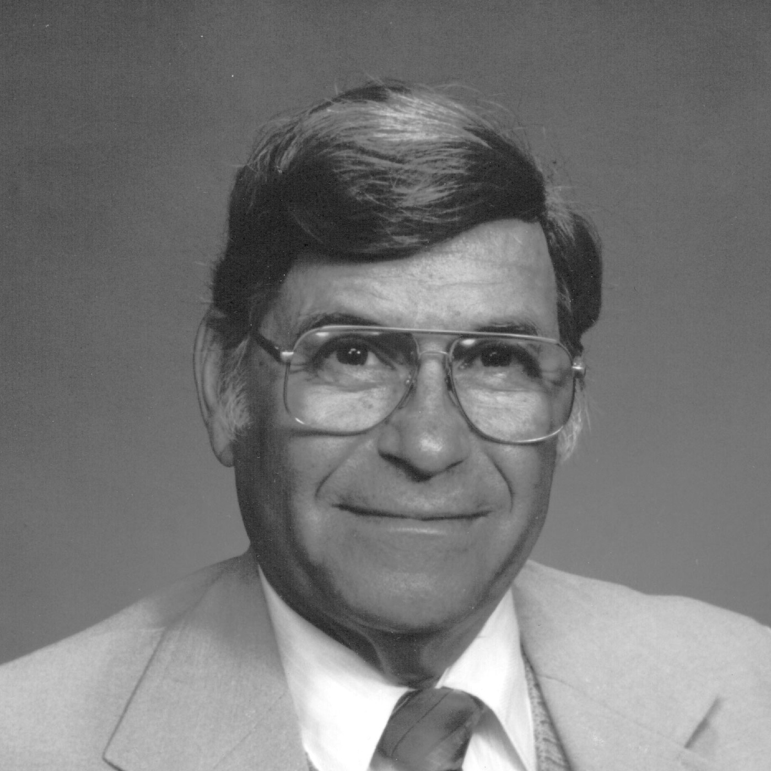
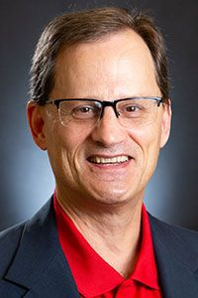
Who are these men?

Slide 34
Who is this?

Slide 35
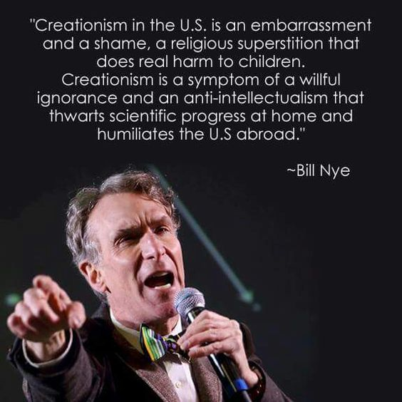
Bill Nye, the “Science Guy”

Slide 37
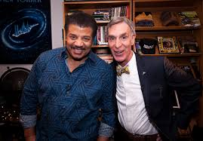
Neil deGrasse Tyson

Slide 39
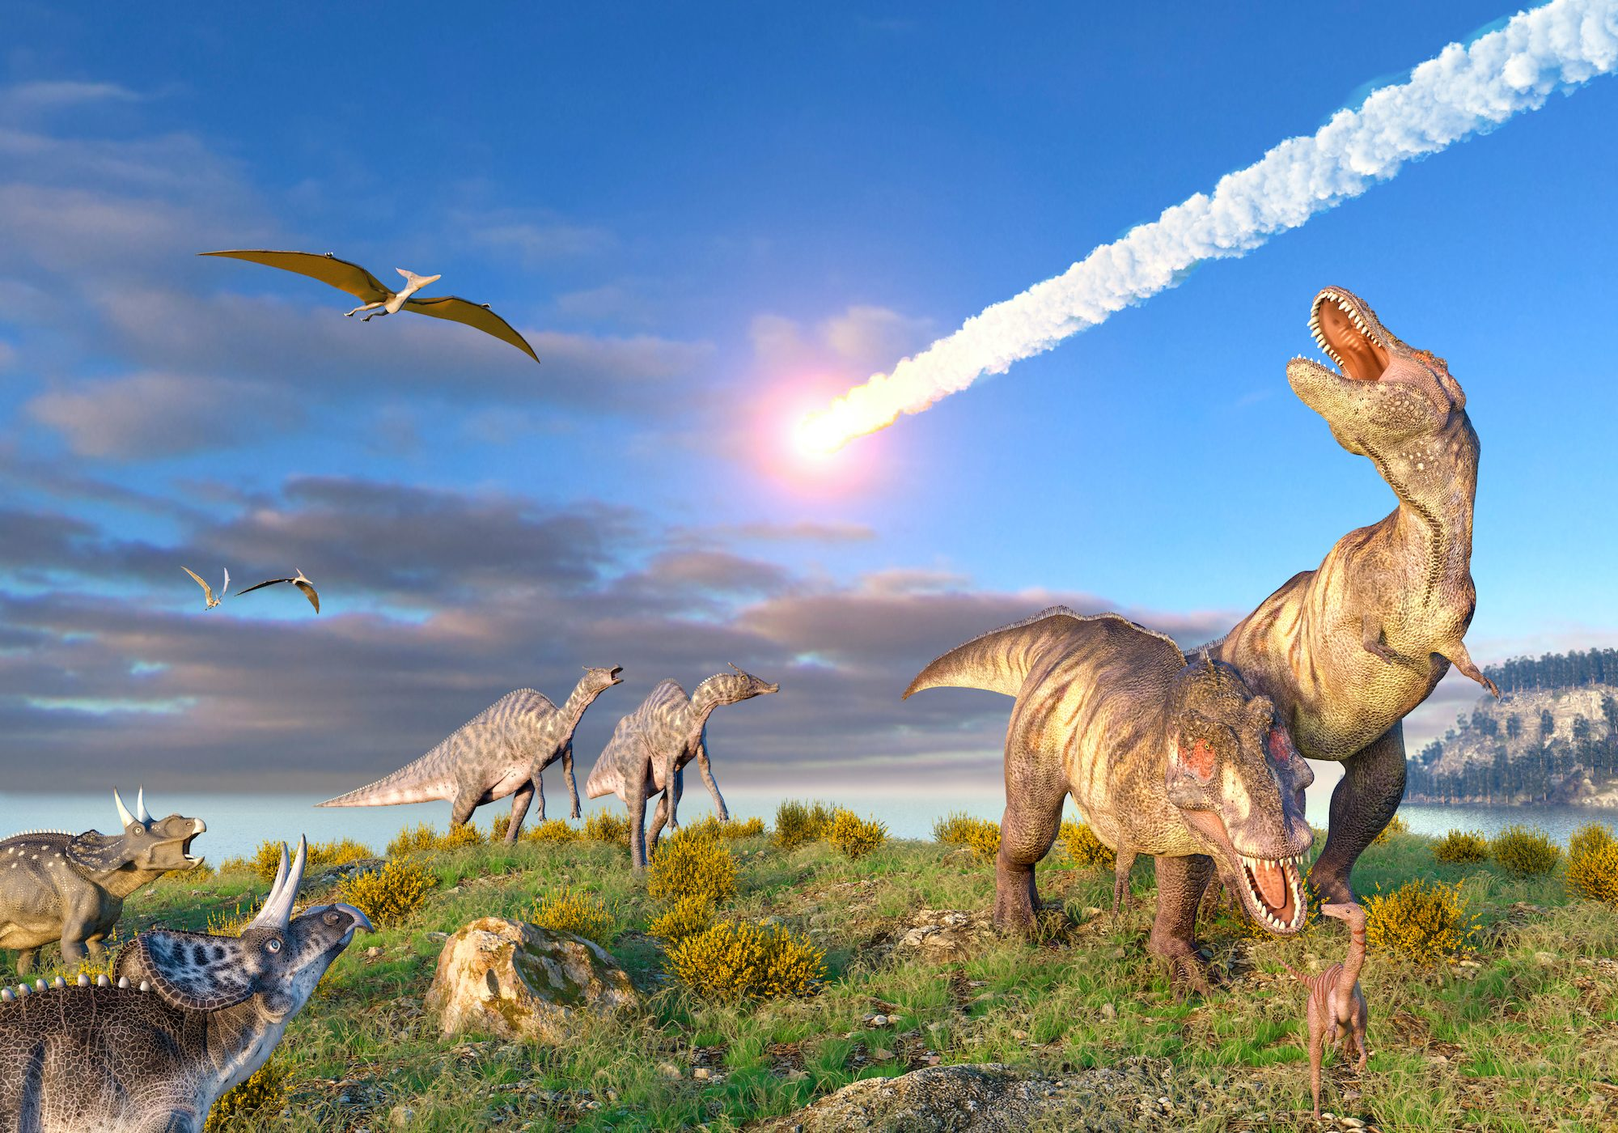
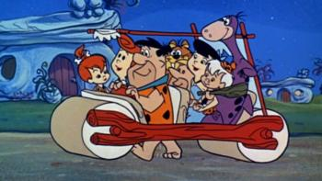

Slide 40
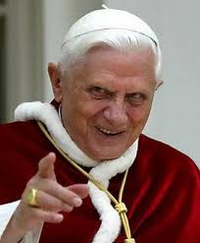
You can’t handle the TRUTH!!!
How do you KNOW the difference between “right” and “wrong”?

Slide 41
Current Issues…Any Basis in Science?
Climate change/CO₂ emission reductions
Transgender theory/Gender vs. biological sex
Gay marriage vs. traditional marriage
Abortion/women’s reproductive rights
Immigration (open vs. closed borders)
Student loan forgiveness
Economic inflation
Government assistance for ALL families (Covid relief, etc.)
1619 vs. 1776 (U.S. historical perspectives)
Slavery reparations
$15/hour minimum wage and economic equity

Slide 42
Absolute truth
There are NO absolutes allowed in many science classrooms today. Neither will you find much in any other subjects, even math!

Slide 43
Moral relativism
“A man who has no assured and ever-present belief in the existence of a personal God or of a future existence with retribution and reward, can have for his rule of life, as far as I can see, only to follow those impulses and instincts which are the strongest or which seem to him the best ones.”
-Charles Darwin

Slide 44
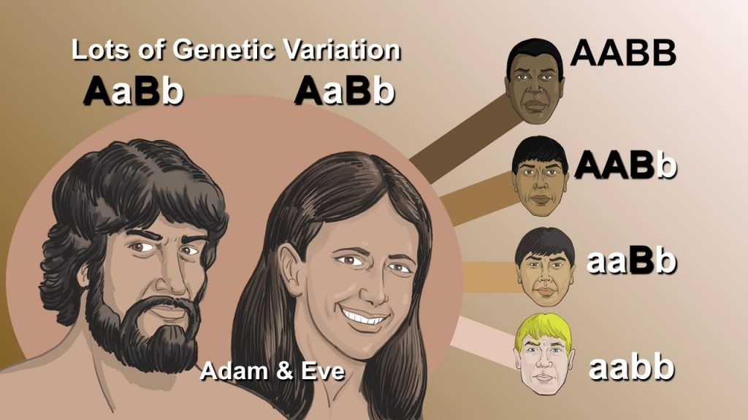
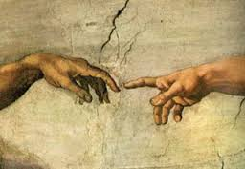
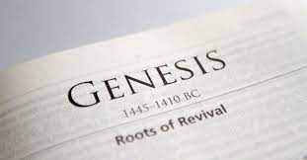
The Importance of Genesis
Genesis means origin; thus, Genesis is the book of origins:
“If the foundations be destroyed, what can the righteous do?”
Psalm 11:3
Origins in Genesis:
Universe, microevolution, life, marriage, language, reproduction, culture, religion, solar system, man, evil, government, carnivorism, nations, human races, God’s chosen people

Slide 45
What is Biblical Creation? (from a YEC perspective)
God supernaturally spoke the Bible to:
40+ men, 3 continents, 1800+ years
It is LITERALLY true
Gen. 1-2: God created everything in SIX DAYS
24 hour-days just like TODAY
Gen. 1:26-29: God created mankind
To worship and serve Him
Mankind has NOT evolved from lower primates
We were created in the image of God AFTER OUR KIND (Day Six of Creation, Gen. 1:26-29)
Everything was created VERY good

Slide 46
What is Biblical Creation? (from a YEC perspective)
Gen. 3: Adam and Eve sinned in the Garden
Began the physical & spiritual downfall of our universe (6,000-10,000 years ago); First animal sacrifice made to clothe humans
Gen. 4-5: Origin of murder
Genetic pool highly varied for replenishing Earth
Gen. 6-8: Noah’s Flood occurred
As a judgment for sinful mankind (~4,400+ years ago); How fossils were formed; catastrophic plate tectonics; seafloor spreading

Slide 47
What is Biblical Creation? (from a YEC perspective)
Gen. 9: Post-Flood Environment
All living things allowed to consume meat; oxygen levels reduced; Earth’s surface mostly water; mankind’s age drastically reduced
Gen. 10: Post-flood genealogies
Record of all people after Noah’s family survived the Flood; record of peoples descending from 8 survivors
Gen. 11: ALL people originated from Tower of Babel dispersion
We were created in the image of God AFTER OUR KIND (Day Six of Creation, Gen. 1:26-29)
Everything was created VERY good

Slide 48
The Meaning of Universe
“In the beginning, God created the heaven and the Earth.” (Genesis 1:1)
“And God said, “Let there be light and there was light.” (Genesis 1:3)

Slide 49
Universe
If….
Uni- means “single”
Verse means “spoken, sentence”
Then….
We live in a single, spoken sentence.

Slide 51
What is meant by a “day?”
“And the evening and the morning were the first day.” (Gen. 1:5)
Time began to be measured by God as darkness (night=evening) passed into light (day=morning)
First Day (night-day cycle)- Day One; repeated on all 6 days of creation week

Slide 52
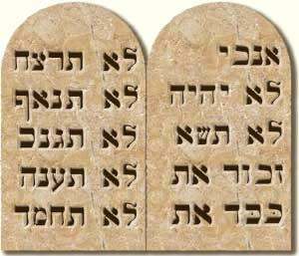
Ten Commandments
God wrote on the stone tablets ….
“Six days shalt thou labor, and do all thy work: but the seventh day is the sabbath of the Lord…for in six days the Lord made heaven and earth, the sea, and all that in them is, and rested on the seventh day.”
(Exodus 20:9-11)

Slide 53
Why didn’t God create everything in 1 day?
It is a template for mankind to best function with life God has created.
God’s 7-day week format would be followed by His creation; He knew we would need rest!
“The Sabbath was made for man, and not man for the Sabbath.”
Mark 2:27

Slide 55
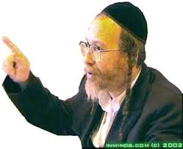
A “regular” day
God established this in creation week
In Hebrew- yowm (plural yamim)
Used over 3,000 times in OT
Gen. 1:5- Precisely used as the passing of darkness into light, one solar day.
Coupled with “evening and morning” expression 38 times, and is accompanied by numerical modifier 359 times

Slide 56
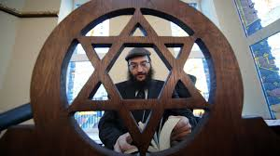
A “regular” day
Plural form appears 845 times
In NONE of the 1,242 references can the word mean anything other than a literal, 24-hour, solar day.
In the REST of the 1,758 times yohm is used in the singular form, it is NEVER used to speak of eon-long age.

Slide 57
Can “day” mean anything else?
“Day” sometimes means unspecified period of time
“day of trouble” (Psalm 20:1)
“day of the Lord” (used 24 times in the OT)
“in the day that the Lord God made the earth and the heavens.” (Gen. 2:4)
The only reason to equate “day” with “age” is to allow for eons of time for evolution to be possible.

Slide 58
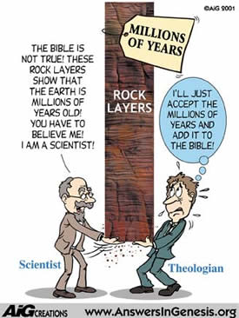
Evolutionary Compromises
(Discussion for next week)
Steady-state theory
Big bang theory
Gap theory
Day-age theory

Slide 59
Why can’t we all just agree?
(3) “Knowing this first, that there shall come in the last days scoffers, walking after their own lusts (for their own glory),
(4) And saying, Where is the promise (Where’s the proof?) of his coming? for since the fathers fell asleep, all things continue as they were from the beginning of the creation. (uniformitarianism)
(5) For this they willingly are ignorant of (Bill Nye admitted this), that by the word of God the heavens were of old, and the earth standing out of the water and in the water.”
2 Pet. 3:3-5

Slide 60
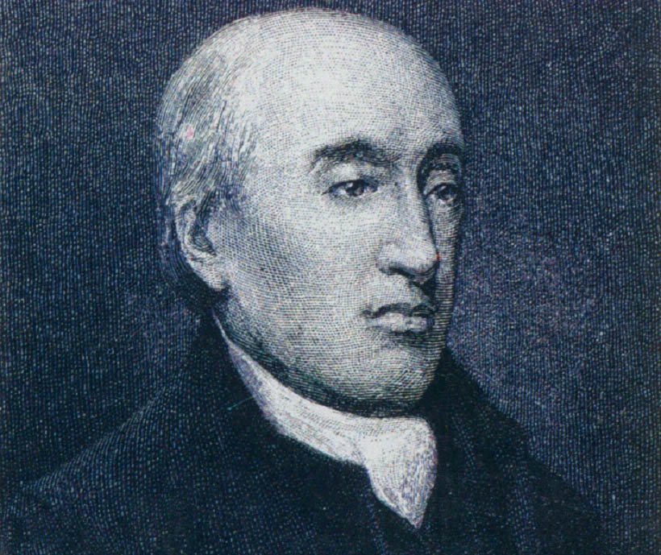
James Hutton
1726-1796,
In his book Theory of the Earth, James said the earth is much older than most people thought.
HBJ
Earth
Science
p.19

Slide 61
What on Earth is Happening?
1750
1800
1850
1900
James Hutton’s book Theory of the Earth was
published in 1795

Slide 62
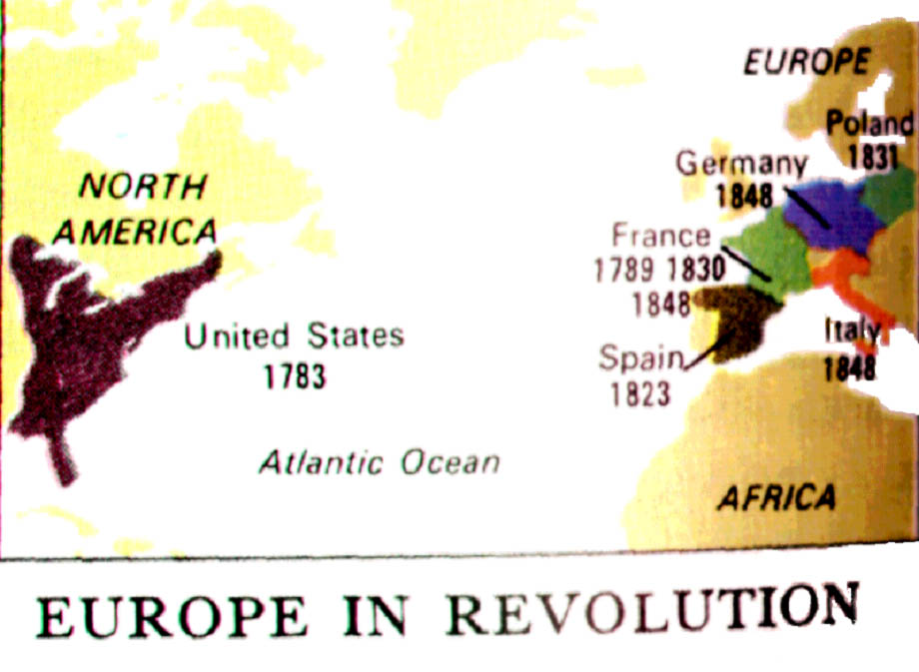

Slide 63
The age of revolutions
and Anti-Monarchy
1750
1800
1850
1900
German
Revolution
1848
American
Revolution
1776
Italian
Revolution
1848
French
Revolution
1789
Spanish
Revolution
1823
Polish
Revolution
1831

Slide 64
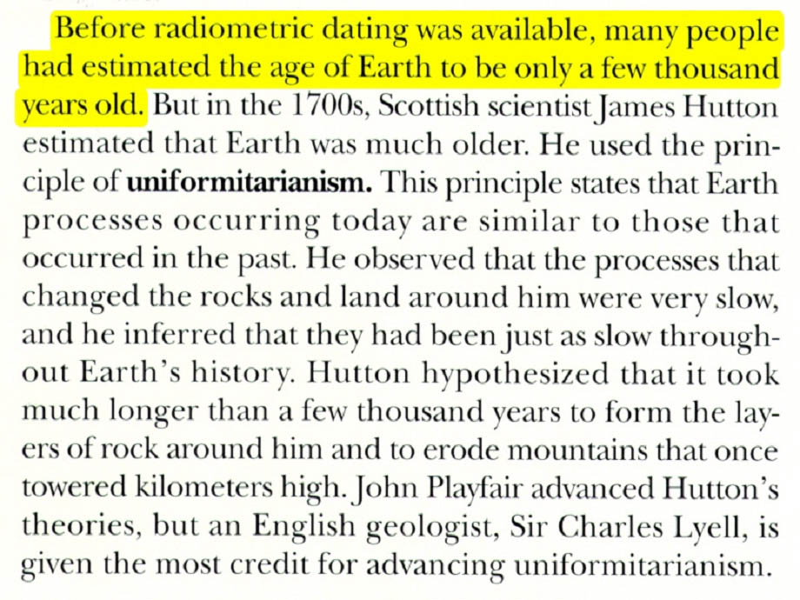
Prentice Hall Earth Science p. 514 “Uniformitarianism…”

Slide 65
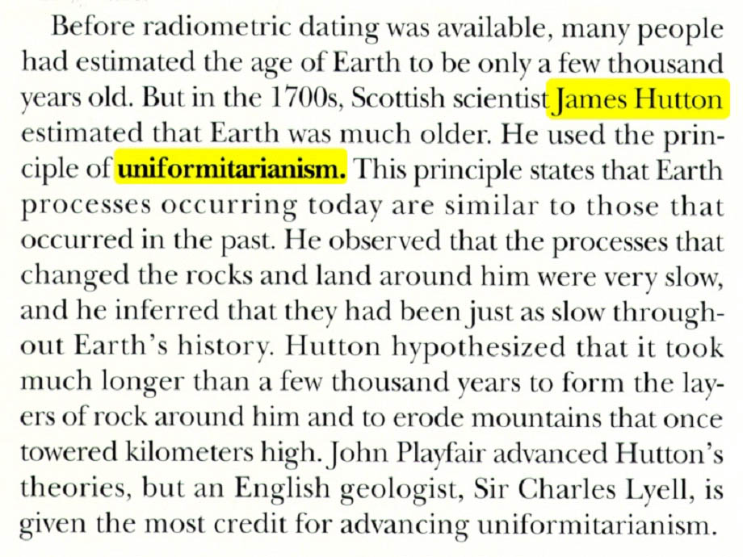

Slide 66
Uniformitarianism: The present is the key to the past.
No! The Bible is the only perfect key to the past.

Slide 67
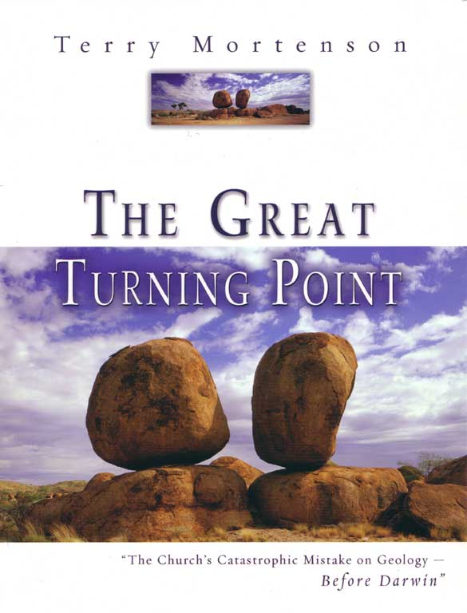
A great book giving the complete story of how the “old earth” view became popular in the 1800’s.

Slide 68
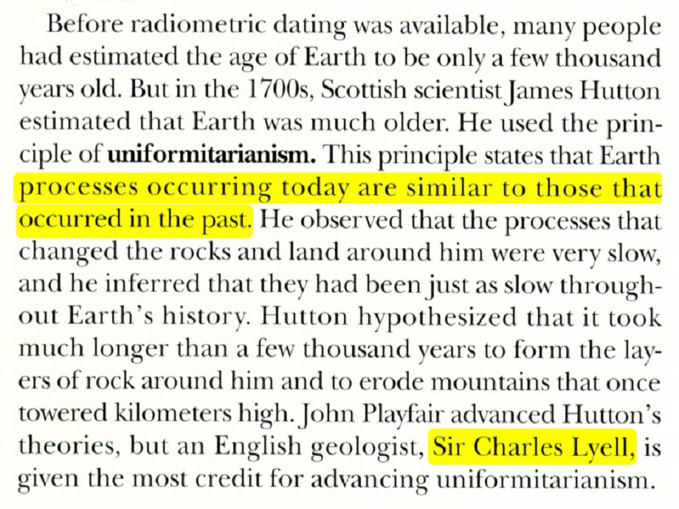

Slide 69
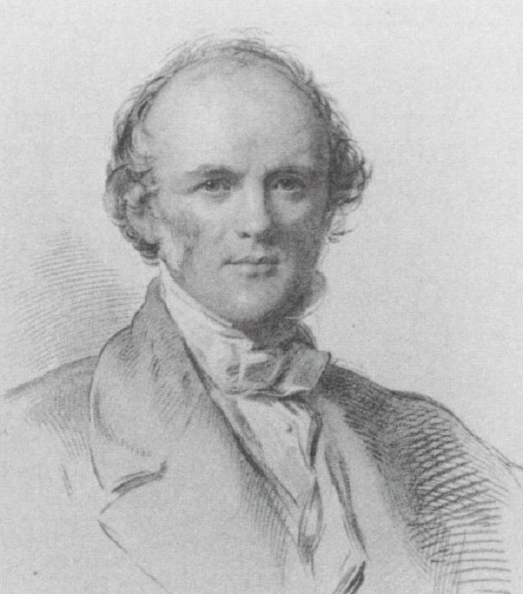
Charles Lyell,
Scottish lawyer

Slide 70
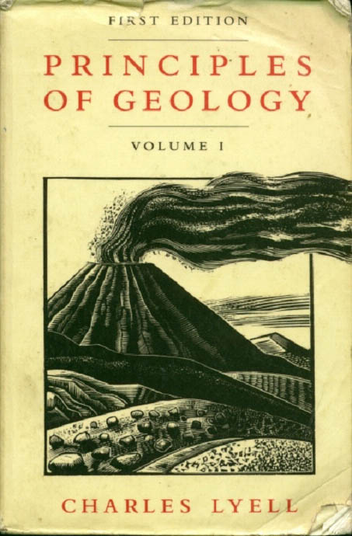
1830

Slide 71
“false conclusions, … futile reasoning… ancient doctrines sanctioned by the implicit faith of many generations, and supposed to rest on scriptural authority.”
Charles Lyell p. 30

Slide 72
“Vallisneri…remarked how much the interests of religion as well as those of sound philosophy had suffered by perpetually mixing up the sacred writings with questions in physical science. … p. 41

Slide 73
(he) reasoned philosophically against …those who regarded the disordered state of earth’s crust as exhibiting signs of the wrath of God for the sins of man” p. 41

Slide 74
“…accusations founded on religious prejudices.”
p. 197

Slide 75
“Men of superior talent (like himself),
who thought for themselves,
and were not blinded by authority (like the Bible)…”p. 302

Slide 76
Lyell said his goal was to “free the science from Moses”
Life Letters and Journals’, published by John Murray 1881.

Slide 77
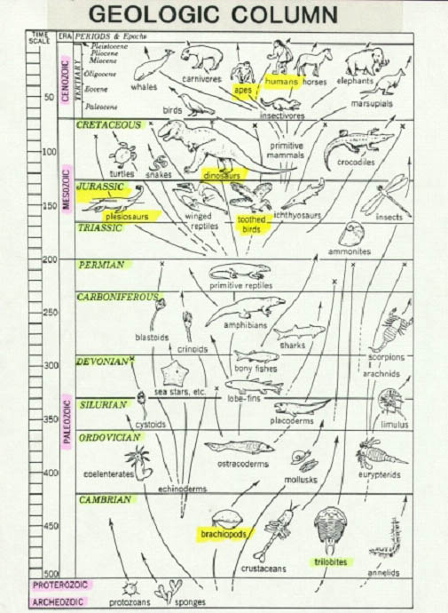
Geologic column
Cretaceous
Jurassic
Triassic
Permian
Carboniferous
Devonian
Silurian
Ordovician
Cambrian

Slide 78
In the early 1800’s
each layer of rock
was given a name
(like Jurassic),
an age and an
index fossil.

Slide 79
Fact
Creationist’s interpretation
Evolutionist’s interpretation
It formed quickly by lots of water and a little time
Grand Canyon exists
It formed slowly by a little water and lots of time
The layers are from the flood of Noah
The earth has layers of sedimentary rock
The layers form slowly over millions of years
Evolutionists are always trying to erase the line and make students think their interpretation is part of the fact

Slide 80
Geologic column is the bible for the evolutionist.
It can only be found one place in the world…
The textbooks!

Slide 82
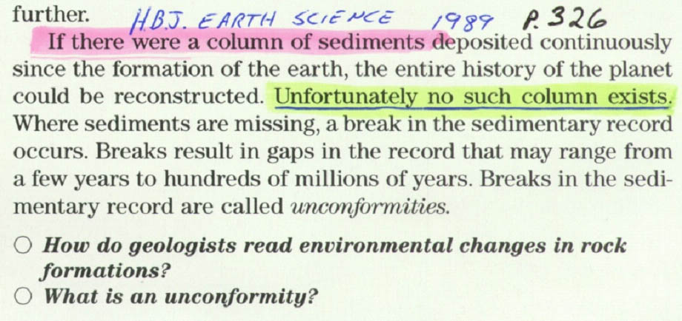
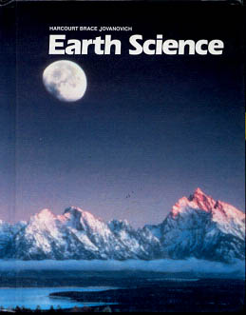
**** “If there were a column of sediments…” (HBJES 1989 p.326)
See also: John Woodmorappe, “The Geologic Column: Does it Exist?” Creation Technical Journal, 13(2): 77-82, 1999

Slide 83
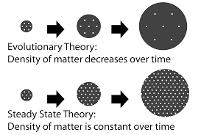
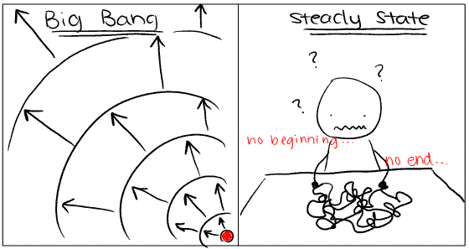
Steady state theory
Unobservable space/matter/energy is evolving out of nothing to compensate for 2nd Law of TD.
Been rejected since 1940’s in favor of big bang theory.

Slide 84
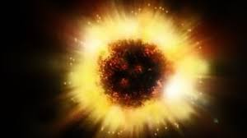
Big bang theory
Theory of our universe’s initiation 16-20 billion years ago
“Cosmic egg” exploded or is expanding that results in our present universe.
Assumes no boundaries, or an infinitely expanding universe
Easily disproven- look at a balloon’s expansion
Could it have a boundary? (i.e. Gen. 1:1)
Universe is clumpy (densities are different everywhere)
Cosmic microwave radiation is uniform everywhere; should be fluctuations
Has speed of light been constant? “Horizon problem”
Principle of conservation of angular momentum
Planets & moons spinning backwards/opposite

Slide 85
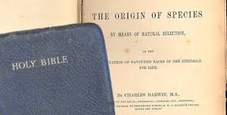
A Test of Faith
“In the beginning God created the heaven and the earth.”
Gen. 1:1
Do we believe what God says?

Slide 86
Gap theory
Assumes “gap” of time between verses 1 & 2
God’s initial creation was destroyed by great catastrophe that left earth “without form and void.”
This theory compromises Biblical text with current “scientific theories.”

Slide 87
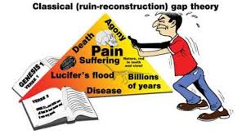
Disproving the gap theory
Gen. 1:2- the word “was” is said to mean “became.”
Every verse in Gen. 1 (verse 27 is exception only in English) begins with conjunction “and” which implies account is strictly sequential with no gaps.
There is no good reason for Hebrew verb for “to be” to be used as “became” in this reference.

Slide 88
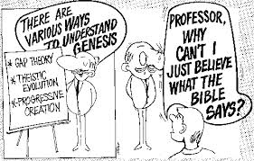
Disproving the gap theory
It contradicts Rom. 5:12, I Cor. 15:21-22, etc.
Death & bloodshed were result of man’s sin; otherwise, Christ’s death is meaningless.
Gen. 1:29-30 implies all animals were originally vegetarians
It contradicts Exodus 20:11

Slide 89
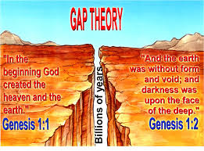
Scientific objections
A global catastrophe denies the geologic column (uniformitarianism) teaching used by old-earth advocates.
If the geologic ages do not exist, there is no need for a gap theory.
Theory indicates that there was no lasting effect of Noah’s flood (i.e. fossils came from previous catastrophe since they are millions of years old).
Theory ignores evidences for a young earth.

Slide 90
Say It Ain’t So!!
Atheism cannot exist because God created the universe.
Pantheism cannot exist because God is transcendent to all He created.
Polytheism cannot exist because only one God created all things.
Materialism cannot exist because matter had a beginning.
Dualism cannot exist because God was alone when He created.
Humanism cannot exist because God, not man, is the ultimate reality and authority.
Evolutionism cannot exist because God created all things.
Theistic evolution cannot exist because of sin and death’s order.

Slide 91
Day-age theory
Each of the days of Genesis 1 corresponds to vast geologic time.
Contradicts Rom. 5:12, I Cor. 15:21-22, etc.
Contradicts Gen. 1:31- everything God created was “very good”
Contradicts Ex. 20:10-11 which teaches us a week of six days work followed by day of rest is modeled after God’s creation week.
Classic example of circular reasoning.

Slide 92
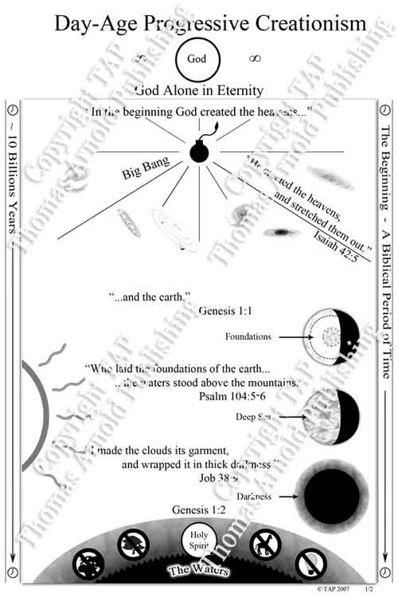

Slide 93
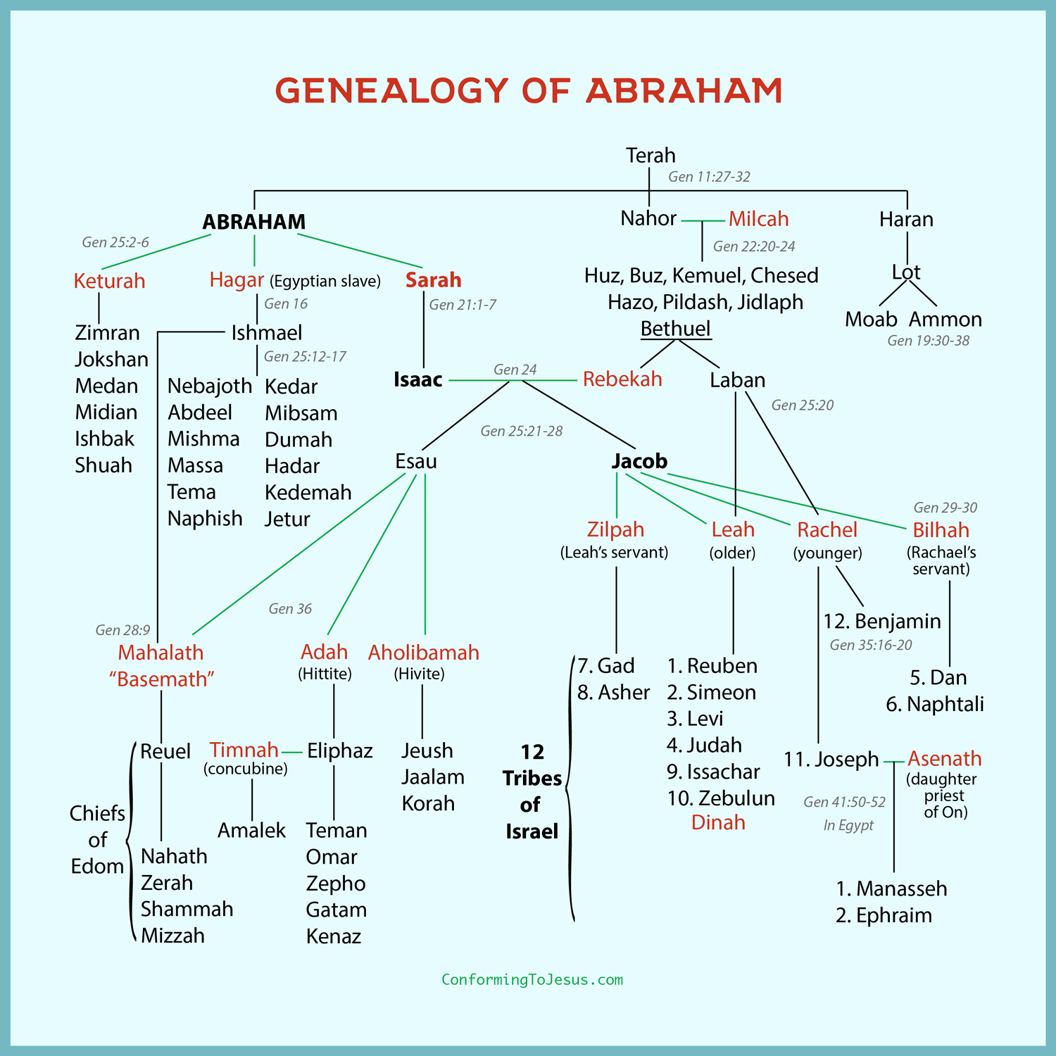
Age of the Earth: Why So Young?
Biblical genealogies reveal age of about 6,000 yrs. (up to 10,000 for possible gaps)
Most ancient civilizations have records as far as only a few thousand years.
Carbon dating (C-14) records a half-life of approximately 5,730 years
Evolutionists must have billions of years to account for “geological ages” and index fossils to account for rocks and fossils buried below the earth.

Slide 96
Age of the Earth: Why So Young?
Evolutionists must have billions of years to account for “geological ages” and index fossils to account for rocks and fossils buried below the earth.
2 Peter 3:5-6

Slide 97
2 Peter 3:5-6 (ESV)
⁵For they deliberately overlook this fact, that the heavens existed long ago, and the earth was formed out of water and through water by the word of God,
⁶ and that by means of these the world that then existed was deluged with water and perished.

Slide 98
Evolution’s Role of Death
Evolution is dependent on death; it is actually a “good” thing for the process. It weeds out the weak and makes “survival of the fittest” possible.
TIME is the essential element for evolution to be a possible explanation.
They are always looking for a
natural way to explain our
origins.

Slide 99
Statistics of Genesis
165 passages in Genesis quoted or alluded to in the NT
At least 200 total quotations or allusions to Genesis in NT
Over 100 quotations or direct allusions to Genesis 1-11 in NT
Every NT writer refers to Genesis 1-11 in writings
Christ is often quoted or alluded to first 11 chapters of Genesis

Slide 100
Genesis= Our Foundation
Genesis is foundational to morality. Without it, morality becomes relative.
With a Genesis foundation, God sets the rules, and morality is no longer relative.
If there is an absolute God, then there are absolute rules (right and wrong)!

Slide 101
Wholesome Human Social Relationships
Monogamous marriage (Gen. 2:21-25; Matthew 19:4-6)
Dominion mandate over physical and animal creation, viewing every honorable occupation as service to God (Gen. 1:26-28; Col. 3:23)
Human government to maintain society (Gen. 9:1-7; Rom. 13:1-7)

Slide 102
True Christianity
Christology- Christ as Creator (John 1:3; Col. 1:16)
Gospel- founded “everlastingly” on God first as Creator (Rev. 14:6-7), then as incarnate saving Word
Saving faith- centered on God’s work as Creator (Heb. 10:38-11:3)
Sound evangelism- purpose of Gospel (John 20:30-31; 1:1-12)

Slide 103
True Christianity
Sound missionary effort- Paul’s example (Acts 14:1, 15-17; 17:2-4, 23-24)
Fellowship (Eph. 3:8-12)
Christian life (Col. 3:10; 2 Cor. 5:17)
Christian home & family (Matt. 19:3-6)
Biblical revelation & inerrancy (Psalm 119:89-90; Heb. 1:1-2)
Redemption (1 Pet. 1:18-21; 2 Tim. 1:9; Titus 1:2)

Slide 104
“For God so loved the world, that he gave his only begotten Son, that whosoever believeth in him should not perish, but have everlasting life.”
Why would God send His son to die for a world that was created by a big bang and evolved by natural causes?
John 3:16

Slide 105
The Bible says…
Death is a judgment, a “curse”
(Gen. 3:17-19)
Death is not “very good,” which God would have pronounced after each creation day (Gen. 1-2)
Death is the “enemy” (1 Cor. 15:26)
Creator will create new heaven and new earth (Rev. 21:1, 4)
Death couldn’t have entered until Adam sinned (Rom. 5:12)

Slide 106
Stay in touch!
Visit www.creationandcompost.com
Audio, video, supporting ministries
Listen to our weekly podcast!
On all major podcasting platforms
(Apple Podcasts, Spotify, etc.)
Check out our FB page!
Also on Instagram
Subscribe to our weekly newsletters!
Will return Jan. 2023

